Slide 1
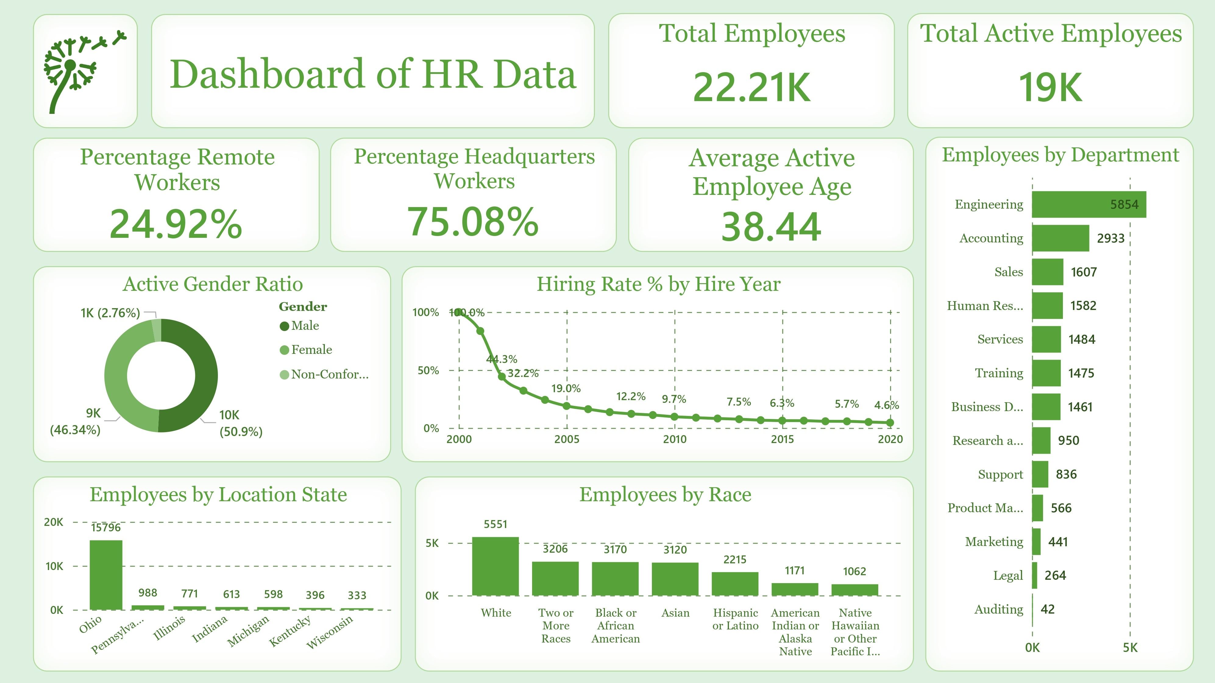
PRDA – 03 HR Analytics
Key Insights & Strategic Suggestions
Project Team ID : PTID-CDA-JUN-25-548 Presented by:
Suraj Kumar Hembram.
Mani Kiran
Patlolla Suprith

Slide 2

PRDA – 03 HR Analytics
Key Insights & Strategic Suggestions
Project Team ID : PTID-CDA-JUN-25-548 Presented by:
Suraj Kumar Hembram.
Mani Kiran
Patlolla Suprith

Slide 3

📊 Overview
Purpose: Present actionable insights from workforce data
Focus areas:
Workforce demographics
Departmental analysis
Strategic recommendations

Slide 4
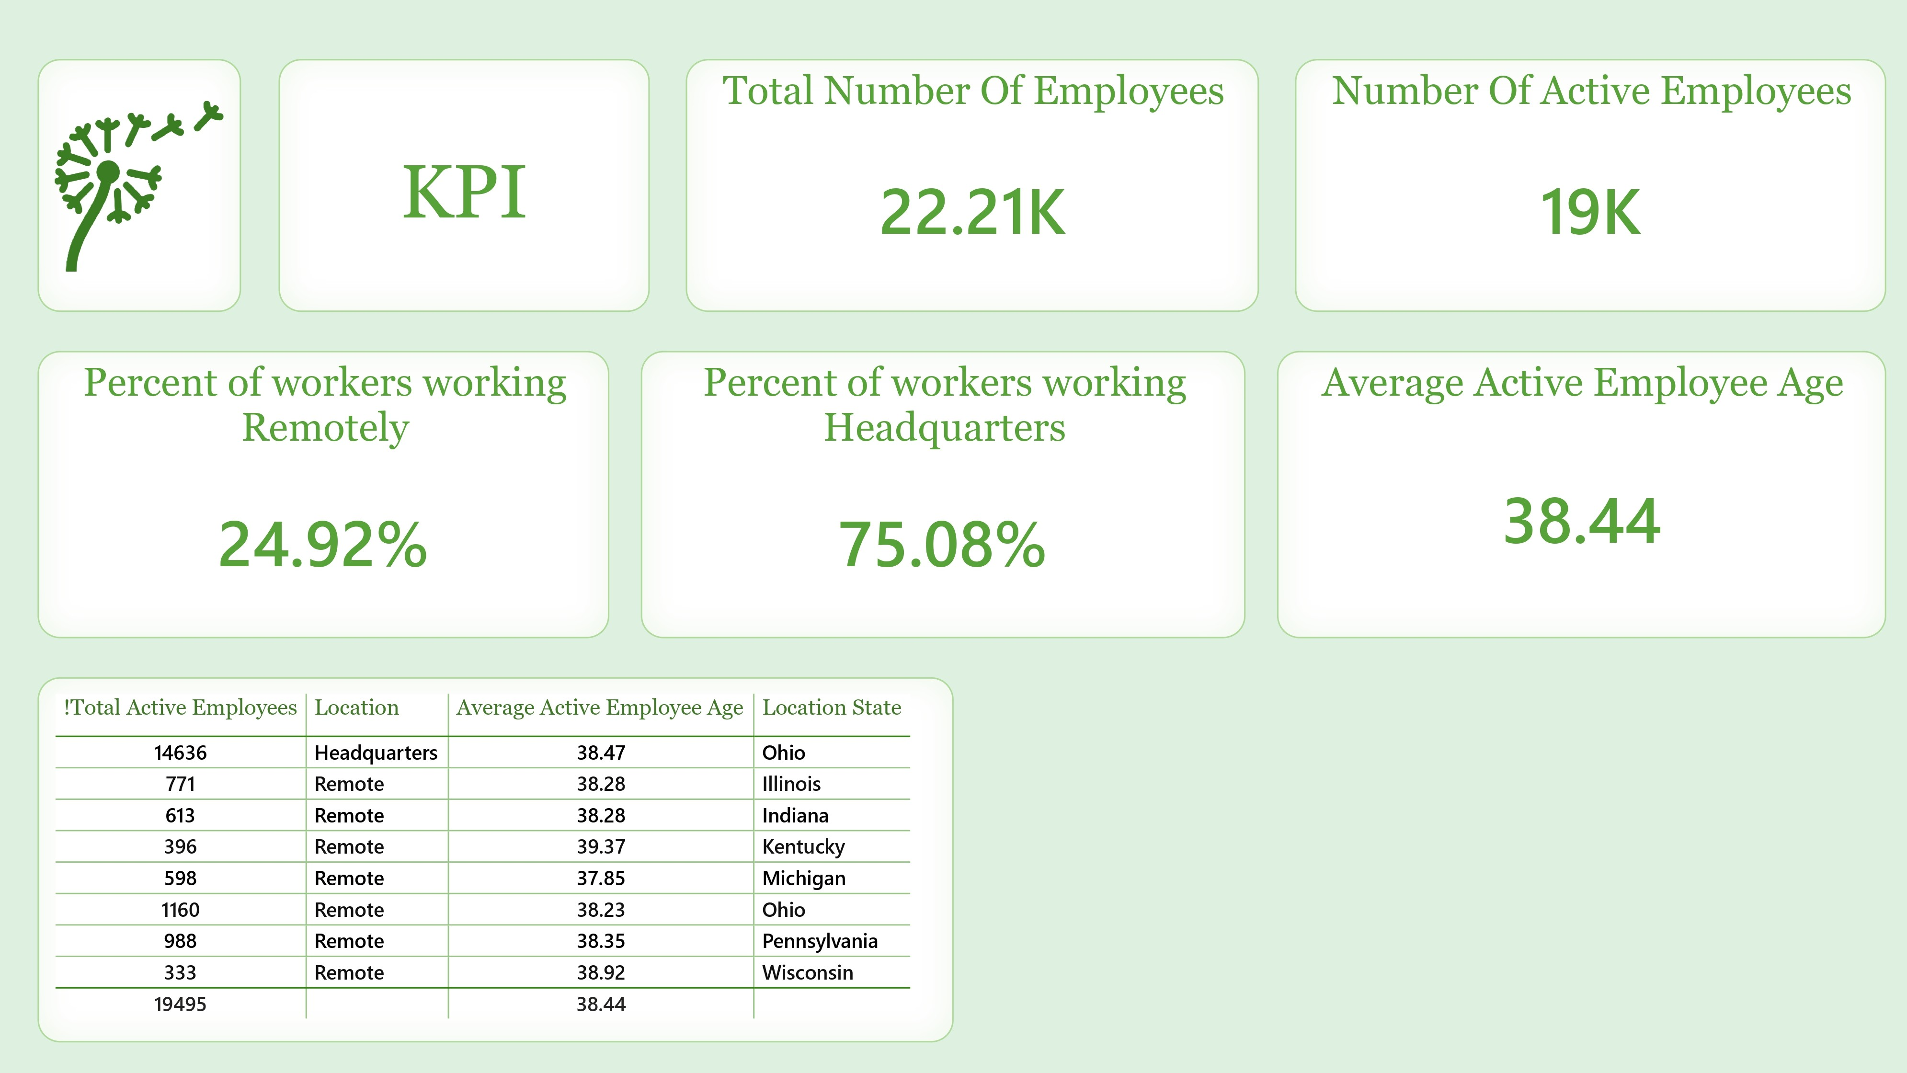


Slide 5

👥Workforce Distribution
Total Employees: 22,210
Active Employees: 19,000
Gender Split: 50.9% Male, 50.9% Female
Location:
Headquarters: 75.08%
Remote Workers: 24.92%

Slide 6

🎯Age & Experience
Average Age of Active Employees: 38.44 years
Implication: Experienced and mature workforce
Opportunity: Tap into tenure and expertise

Slide 7

🌍Diversity & Inclusion
Representation across racial and ethnic backgrounds
Benefits:
Diverse perspectives
Increased innovation
Strategic focus: Continue expanding inclusion
initiatives

Slide 8

🧪Departmental Snapshot
Largest Department: Engineering (5,854 employees)
Insight: Strong technical emphasis
Recommendation: Balance support across departments

Slide 9

🏡Suggestions - Remote Work
Current remote population: ~25%
Suggestion: Expand remote options
Enhance flexibility
Attract broader talent pool

Slide 10

💡Suggestions - Mentorship Programs
Leverage experienced employees
Facilitate knowledge sharing
Bridge gaps between generations

Slide 11
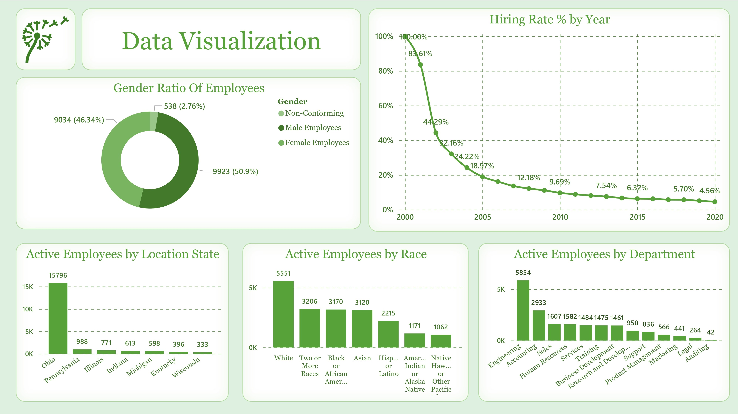


Slide 12

🧭Suggestions - Data & Visualization
Invest in dynamic data visualization tools
Benefits:
Trend analysis
Strategic decision-making
Easier communication of insights

Slide 13

🔄Ongoing Monitoring
Regularly review HR metrics
Adapt to workforce shifts
Maintain alignment with business goals

Slide 14

✅Conclusion
Optimizing workforce management
Supporting employee satisfaction
Strategic alignment with long-term objectives

Slide 15
🙏 Thank You
We sincerely appreciate your time and attention in reviewing our HR Data Analytics insights.
– Suraj Kumar Hembram, Mani Kiran, Patlolla Suprith Project Team ID: PTID-CDA-JUN-25-548

